Slide 1

Linear Regression
Notes:
Entry point of ML
Popular and important algo
Core of Deep Learning.

Slide 2
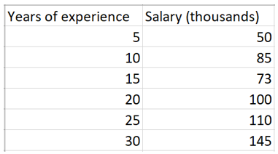
Salary vs Experience (in years)
Notes:
Comparison betn experience and salary.
Any pattern!?
Great, this is the data collected.
How do we estimate the salary for 17 years of work experience or say 40 years of experience?

Slide 3
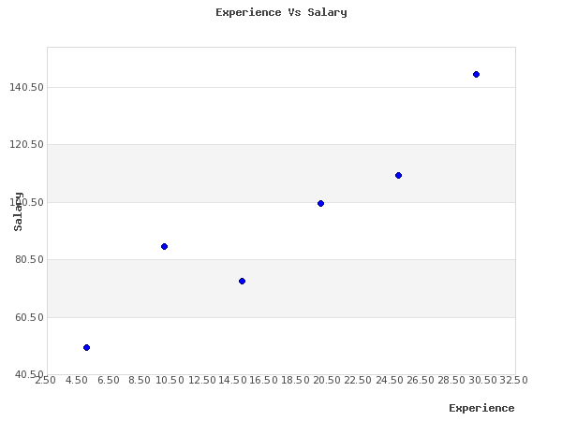

Slide 4
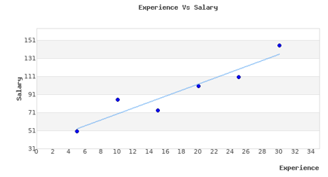
This might help you
Notes:
Pictorial rep of the data
Can you see the line here?
All the points lie somewhat above or below the line.
What if we told you, that if you found out what this line is, you’ve done linear regression.
All the points we have plotted is our actual value and the points that the line plots would be the predicted value of our model.
So, any ideas on how we can get this line?

Slide 5
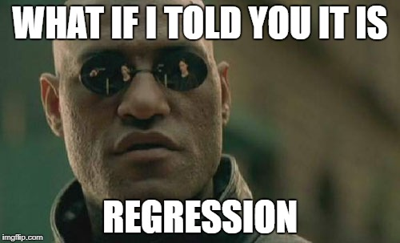

Slide 6
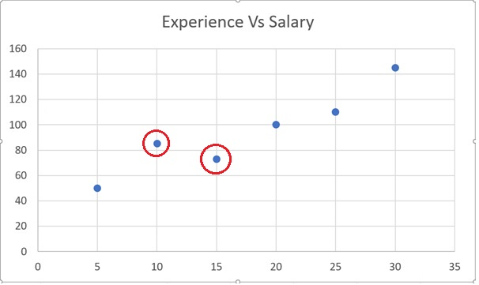
Notes:
Joining two dots?
If we just pick 2 points and draw a line, how will that turn out to be?

Slide 7
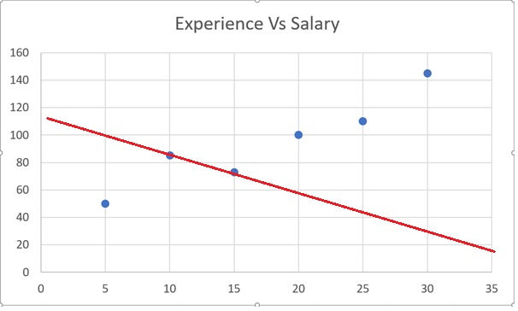
Notes:
Machine randomly picks 2 dots and connects it, it may fail
Apt for some and bizzare for some.
Like in this case max sal with min experience and vice versa
We get max salary for no experience. Not everyone is kylie jenner.

Slide 8
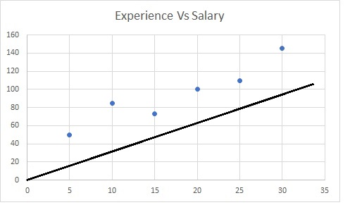
Notes:
Ask?
Does this line fit? What’s the issue with this?

Slide 9
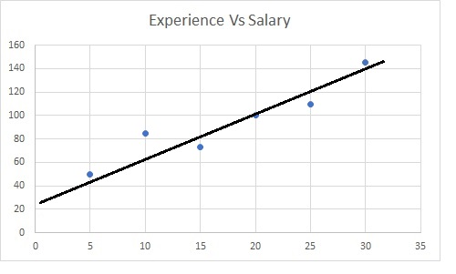
Notes:
How about this line?
Why is this line better than the previous one?
Closeness of the points to the line?

Slide 10
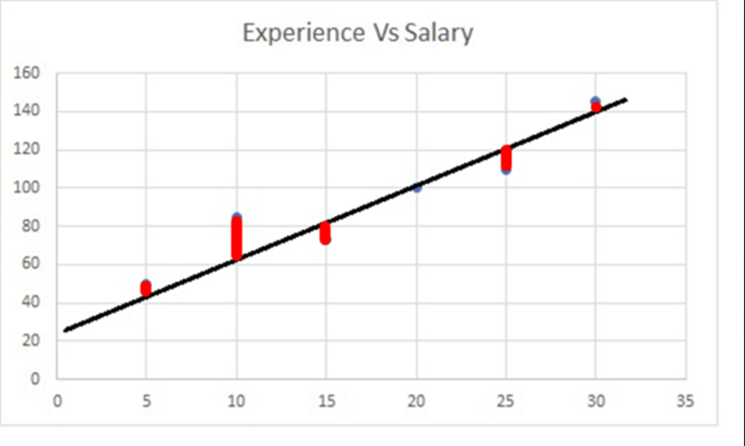
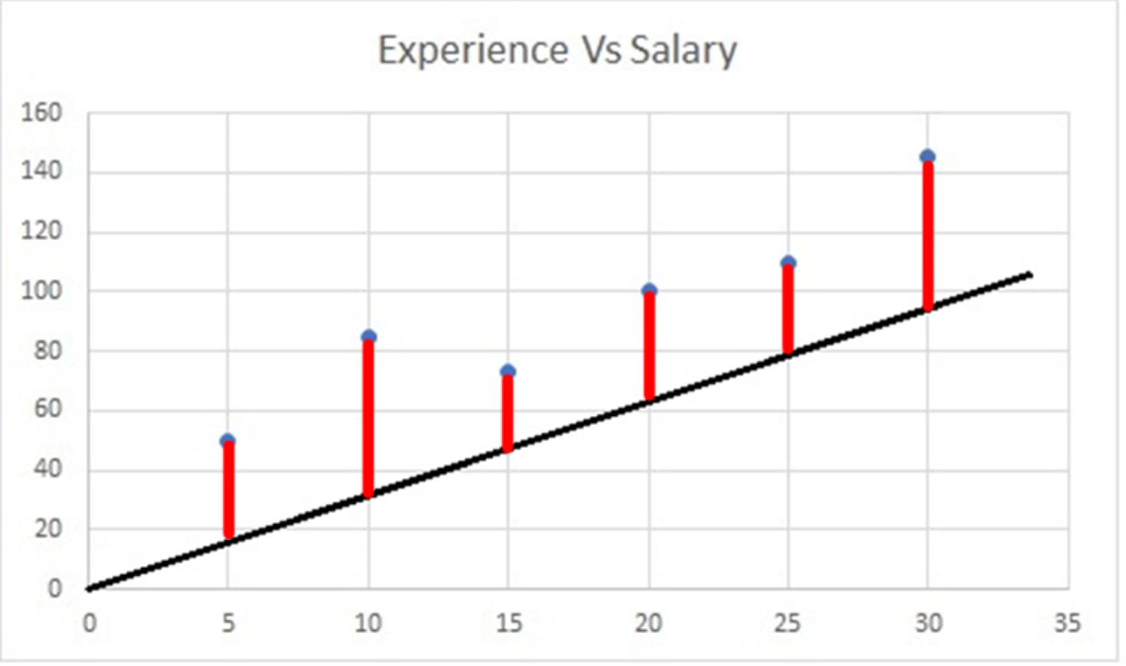
Intuitively,
Error = Correct value – Predicted value
Notes:
This closeness which you talked about is called ERROR. It is the difference betn the actual value we have plotted and the predicted value at a particular point. The line best fit is where the actual and predicted value for almost all the points are close enough, i.e. the overall error should be min.

Slide 11
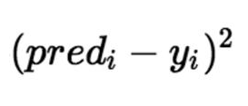
Loss

Slide 12
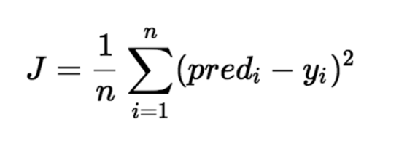
Notes:
So to find the error in mathematical terms we would square the diff betn pred and actual value.
Squaring the error helps us in 2 ways-
MOD func, gives us the net error and no cancelling
Doesn’t give equal weightage to both huge and small errors. Maximizes the huge errors and minimizes the small ones
Put the intuitive value - predicted value

Slide 13
Notes:
This is called the loss or error function.
Now our aim is to minimize this loss function.

Slide 14
Loss function

Slide 15
y = mx + b
m and b are the 2 parameters that make up the line.
Our job:
Find m, b such that there is minimum loss for that line.

Slide 16
Features, weights and biases
A feature is an individual measurable property or characteristic of a phenomenon being observed.
The weight is the coefficient of a feature.
Bias is then used to shift the output.
The output of the combination is called a label.

Slide 17
salary = weight*experience + bias
y m*x + b

Slide 18
Reducing loss – intuition
Start with some random values of m and b
Compute the loss
Update m and b
Repeat step 2
[y=mx+b]

Slide 19
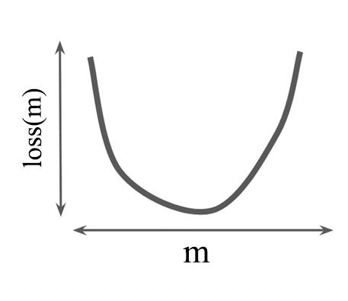

Loss(m)
$$y_{i}=mx_{i}+b$$
Notes:
No u.

Slide 20
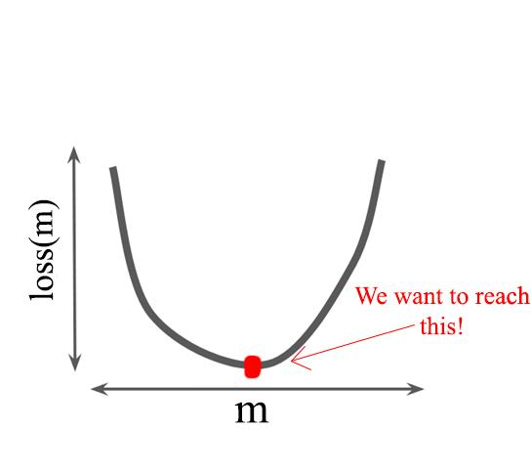

Slide 21
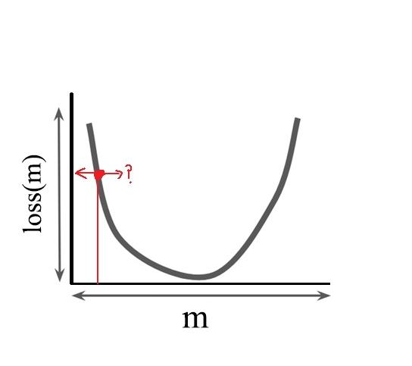

Slide 22
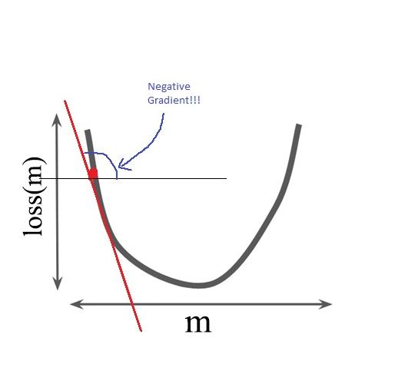

Slide 23
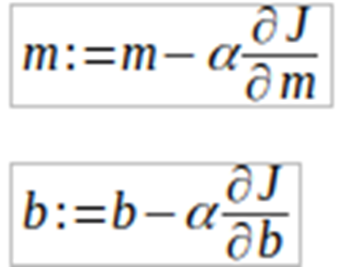

Slide 24
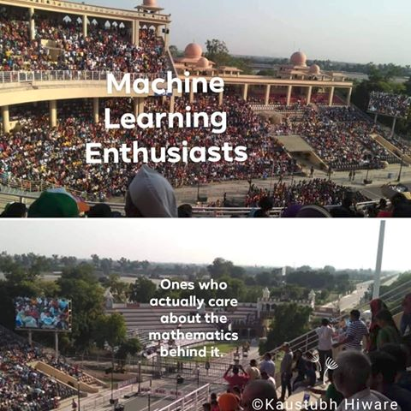

Slide 25
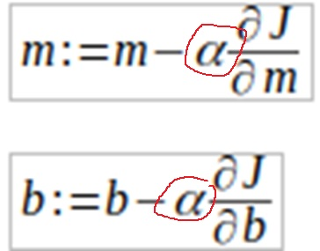
Learning Rate
Notes:
So as Ankush told you, that we need to shift small steps towards the minima or the vertex of the parabola. But what are these steps like? How do we quantify by how much do we shift in each iteration?
Here comes the concept of Learning Rate. Learning rate is basically the amount of shifting we do for each iteration in order to reach the minima. So alpha will decide on how big or small each step to reach the minima. So what do you think, what would be the apt value for alpha?
Whats happening with this learning rate?
How to decide this?

Slide 26
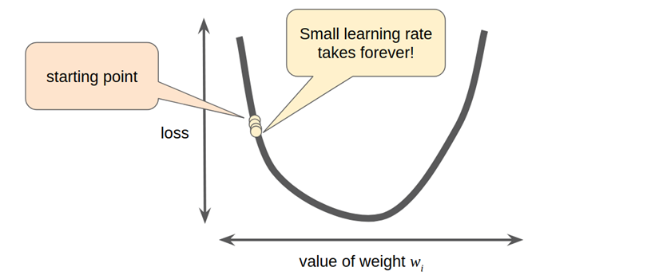
Notes:
If alpha is small, it will take forever to reach the minima that means more computation and more time consuming.
So this isn’t efficient or viable.

Slide 27
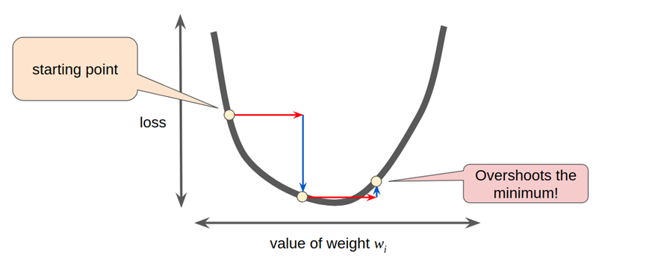
Notes:
But on the other hand if we take a huge value of alpha, there may be a chance that we get close to the minima, but then just overshoot it!!

Slide 28
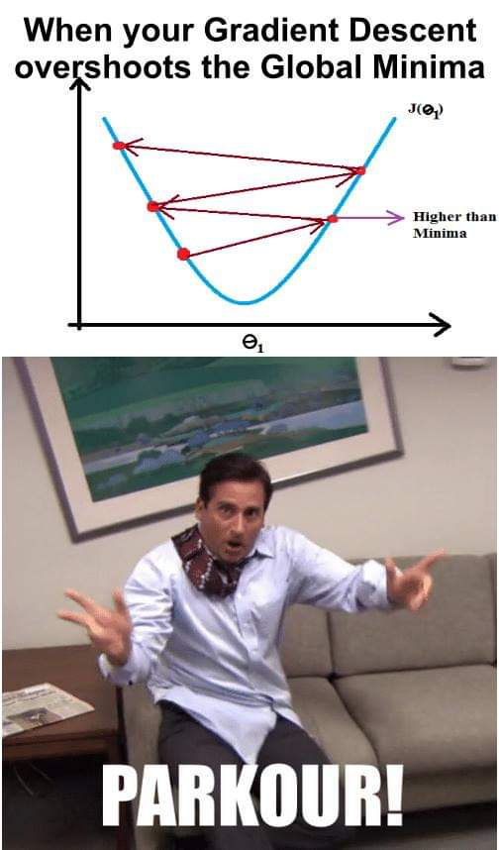

Slide 29
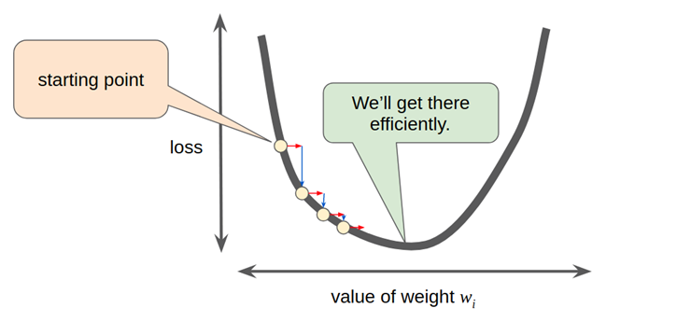
Optimum Value of Learning rate is a found by experience
and some trial and error
Notes:
Hence the value of alpha should be apt.Not too huge nor too small.

Slide 30
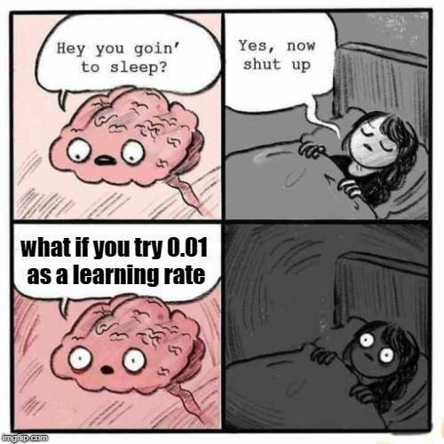

Slide 31
Recap
Our line equation is y=mx+b
Start with random values of m, b
Compute loss, update m, b
Update m, b based on the loss
Repeat step 3-4, n number of times
Optimum m, b obtained
Plug m, b in the equation
Now you have the line
Finally, you can get your prediction for each value of x
Notes:
So let’s just recap what we learnt.
In order to fix or place our line in order to get the minimum loss, we need to start by taking any random values of m and b, and then compute the loss.
We shift our values of m and b accordingly and try again until we reach minimum loss for each parameter.
So then you finally have a m and a b, just plug it into the line eqn and plot your line.
Cool?

Slide 32
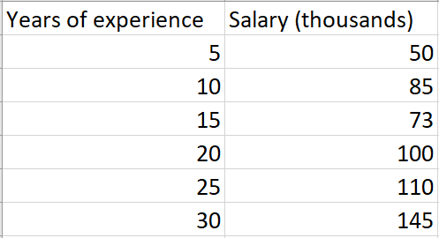
Let’s go back to our example

Slide 33
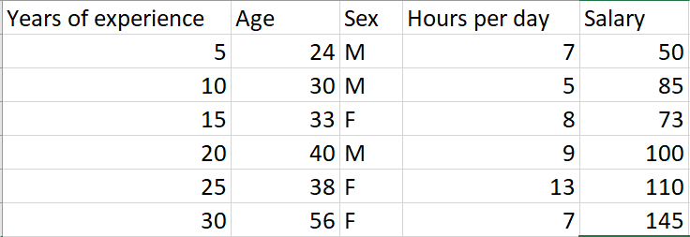
Often, the reality is like this..

Slide 34
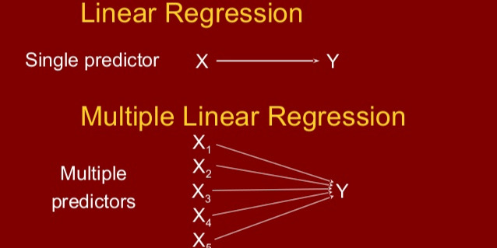

Slide 35
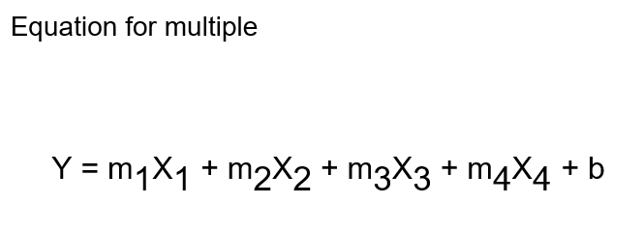

Slide 36
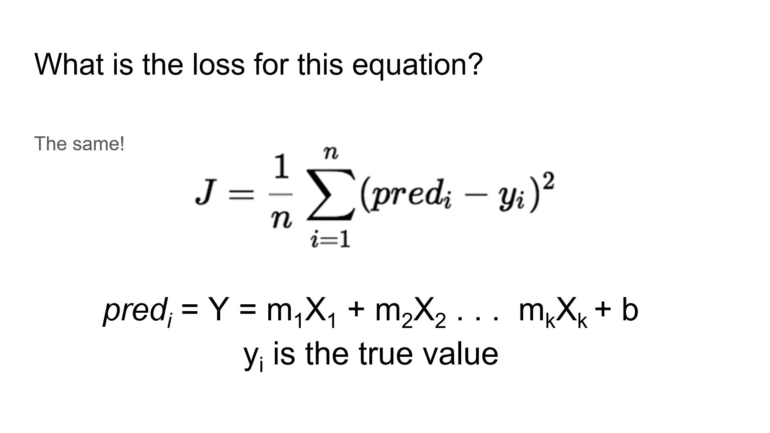

Slide 37
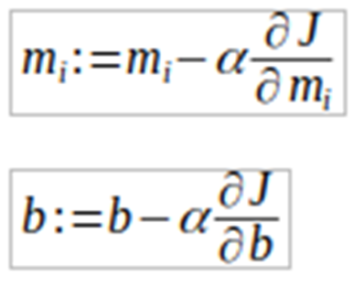

Slide 38
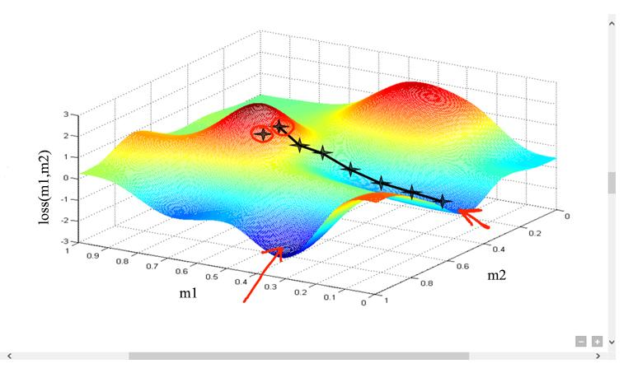
Graph of multiple - intuition using 3d
Notes:
Change para

Slide 39

